Slide 1
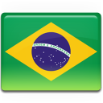
Global Markets of Smate Device

