Slide 1
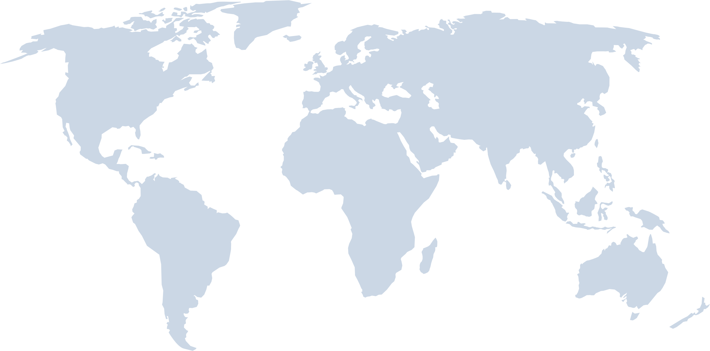
Global Markets of Smart Devices

